Slide 1
Module-5 Query Processing
Dr. Parimala M
SCORE

Slide 2
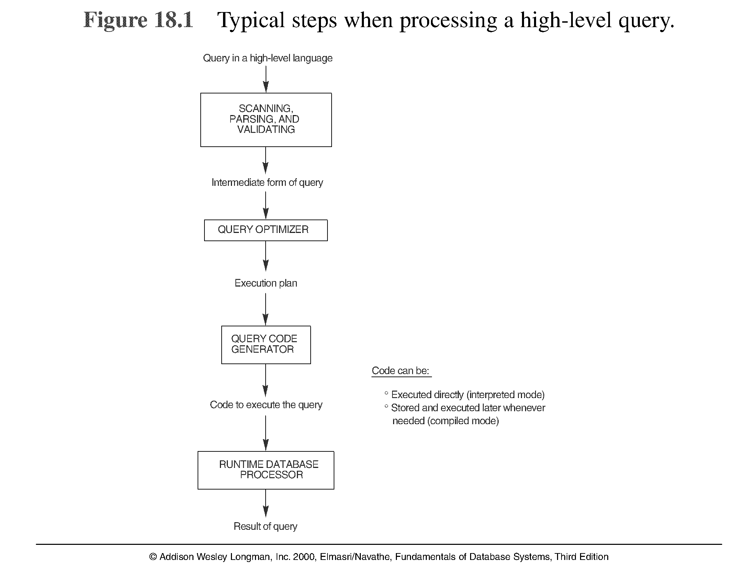
Introduction to Query Processing (2)

Slide 3
1. Translating SQL Queries into Relational Algebra
Query block: the basic unit that can be translated into the algebraic operators and optimized.
A query block contains a single SELECT-FROM-WHERE expression, as well as GROUP BY and HAVING clause if these are part of the block.
Nested queries within a query are identified as separate query blocks.
Aggregate operators in SQL must be included in the extended algebra.

Slide 4
Translating SQL Queries into Relational Algebra
SELECT LNAME, FNAME
FROM EMPLOYEE
WHERE SALARY > ( SELECT MAX (SALARY)
FROM EMPLOYEE
WHERE DNO = 5);
SELECT LNAME, FNAME
FROM EMPLOYEE
WHERE SALARY > C
SELECT MAX (SALARY)
FROM EMPLOYEE
WHERE DNO = 5
π_{LNAME, FNAME} (σ_{SALARY>C}(EMPLOYEE))
ℱ_{MAX SALARY} (σ_{DNO=5} (EMPLOYEE))

Slide 5
Using Heuristics in Query Optimization
Process for heuristics optimization
The parser of a high-level query generates an initial internal representation;
Apply heuristics rules to optimize the internal representation.
A query execution plan is generated to execute groups of operations based on the access paths available on the files involved in the query.
The main heuristic is to apply first the operations that reduce the size of intermediate results.
E.g., Apply SELECT and PROJECT operations before applying the JOIN or other binary operations.

Slide 6
Using Heuristics in Query Optimization
Query tree: a tree data structure that corresponds to a relational algebra expression. It represents the input relations of the query as leaf nodes of the tree, and represents the relational algebra operations as internal nodes.
An execution of the query tree consists of executing an internal node operation whenever its operands are available and then replacing that internal node by the relation that results from executing the operation.
Query graph: a graph data structure that corresponds to a relational calculus expression. It does not indicate an order on which operations to perform first. There is only a single graph corresponding to each query.

Slide 7
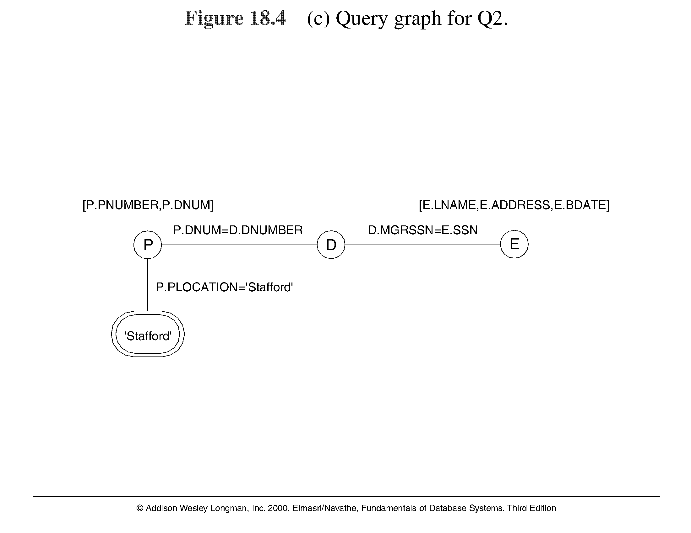
Query graph

Slide 8
Using Heuristics in Query Optimization
Heuristic Optimization of Query Trees:
The same query could correspond to many different relational algebra expressions — and hence many different query trees.
The task of heuristic optimization of query trees is to find a final query tree that is efficient to execute.
Example:
Q: SELECT LNAME
FROM EMPLOYEE, WORKS_ON, PROJECT
WHERE PNAME = ‘AQUARIUS’ AND PNMUBER=PNO
AND ESSN=SSN AND BDATE > ‘1957-12-31’;

Slide 9

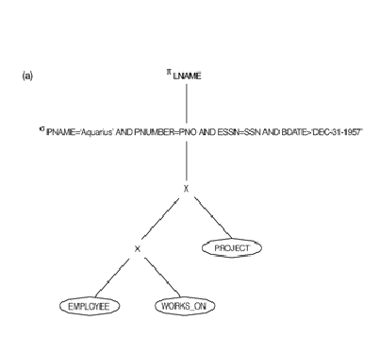
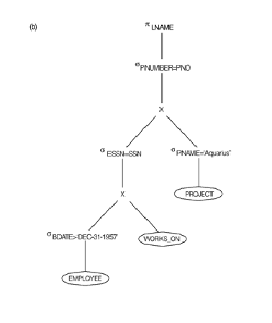

Slide 10
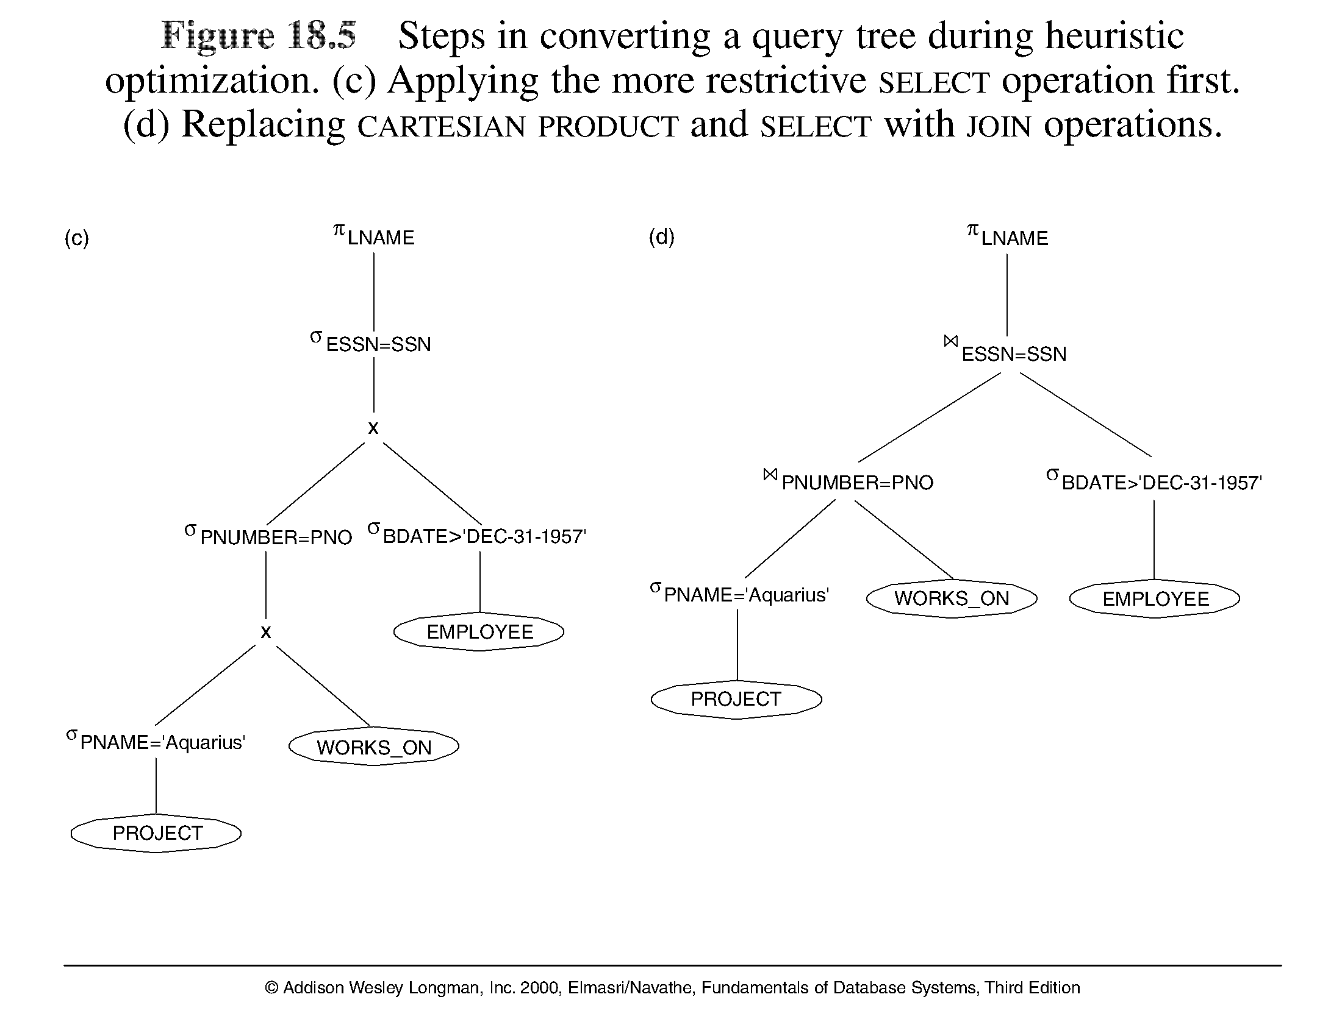
Using Heuristics in Query Optimization

Slide 11
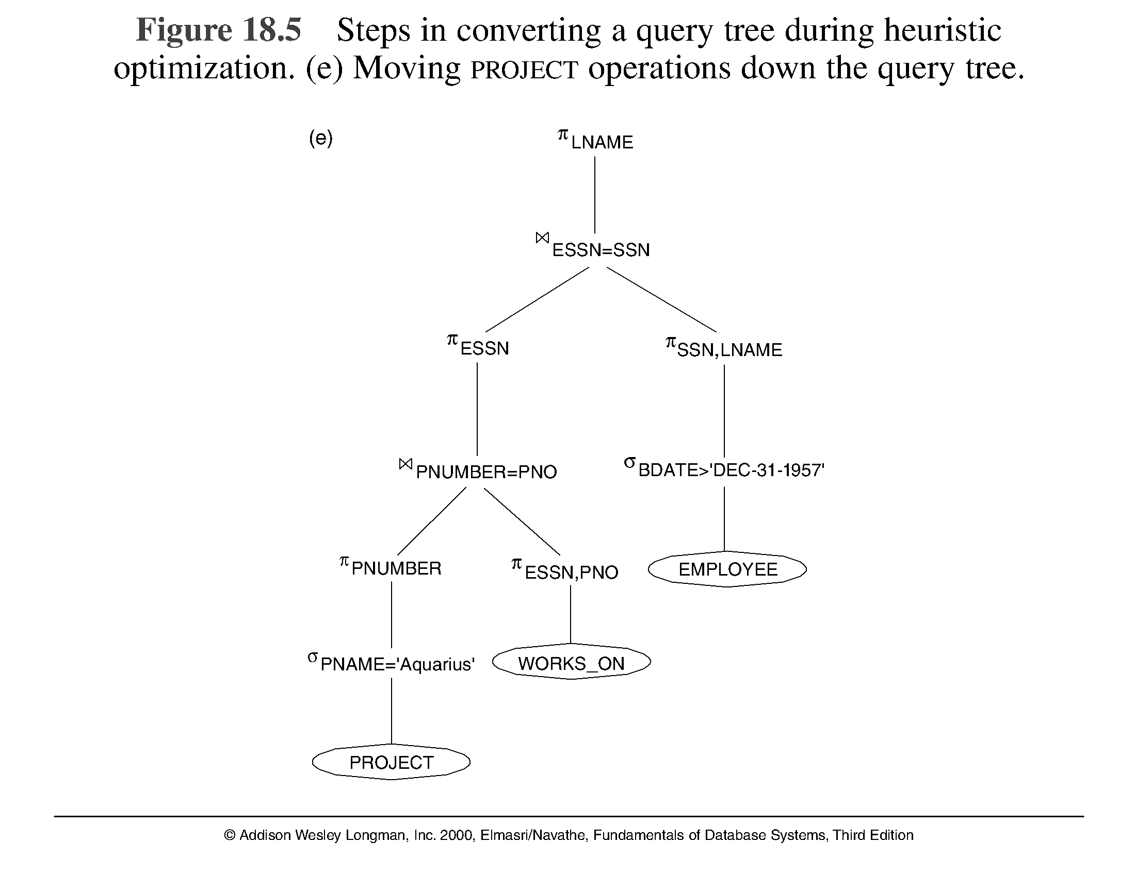
Using Heuristics in Query Optimization

